Slide 1
xChip Introduction
Get to know your equipment

Slide 2
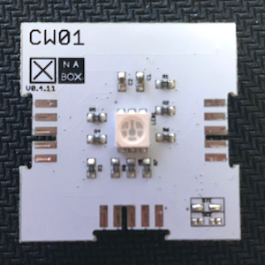
CW01
This is your processor. It is the brains of your XinaBox kit.
It has WiFi capabilities, but you can’t surf the web with it. The WiFi ability is so that you can log into the processor and change settings.

Slide 3
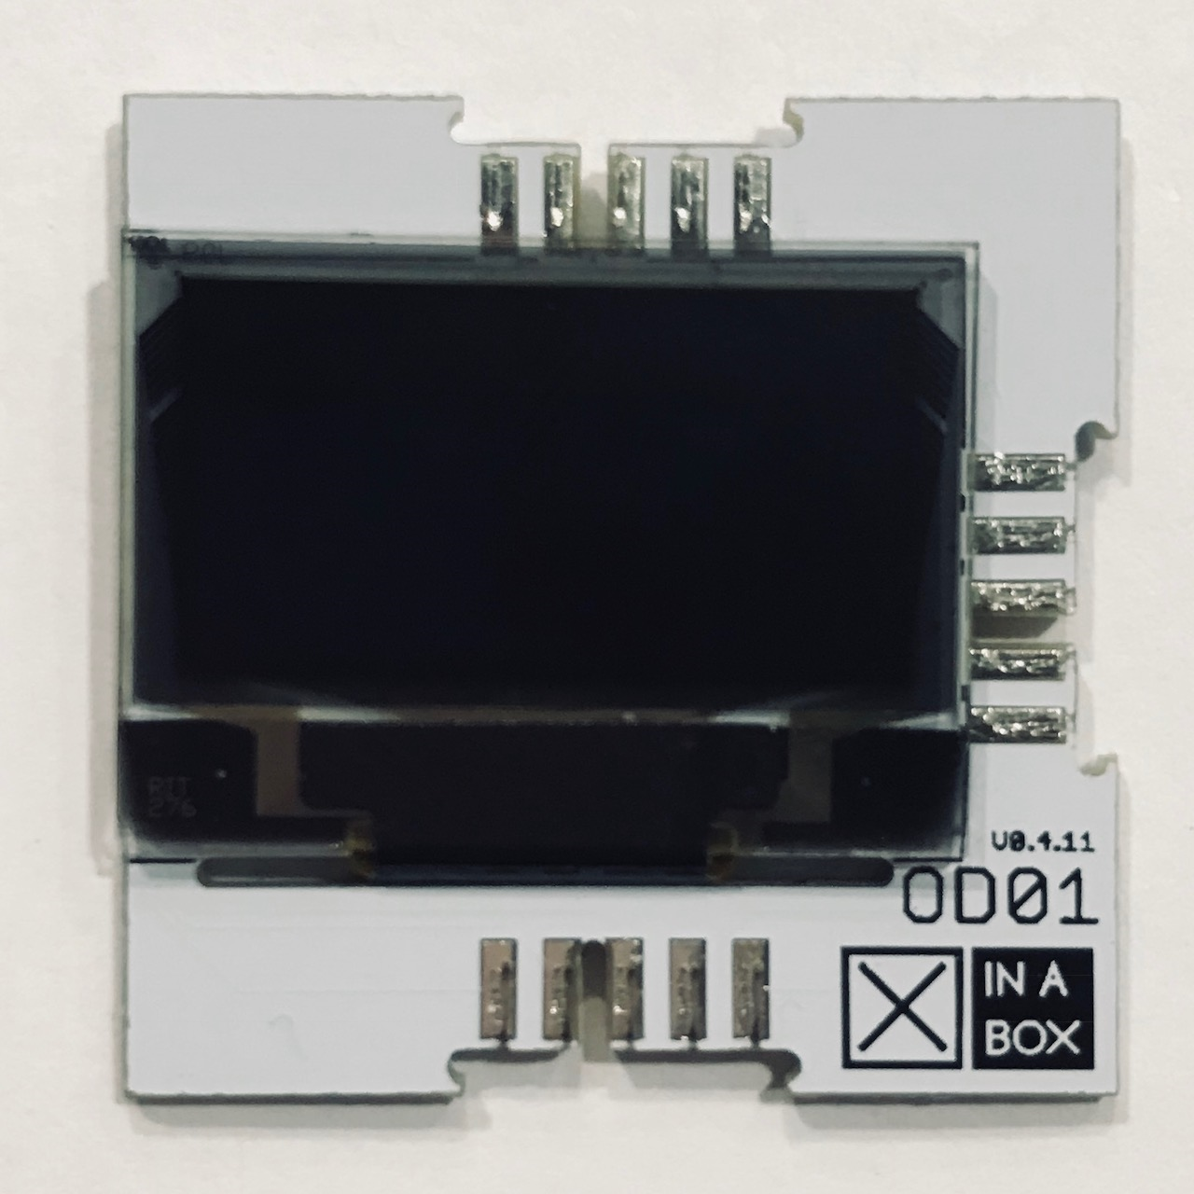
OD01
The LED Screen
This module displays data

Slide 4
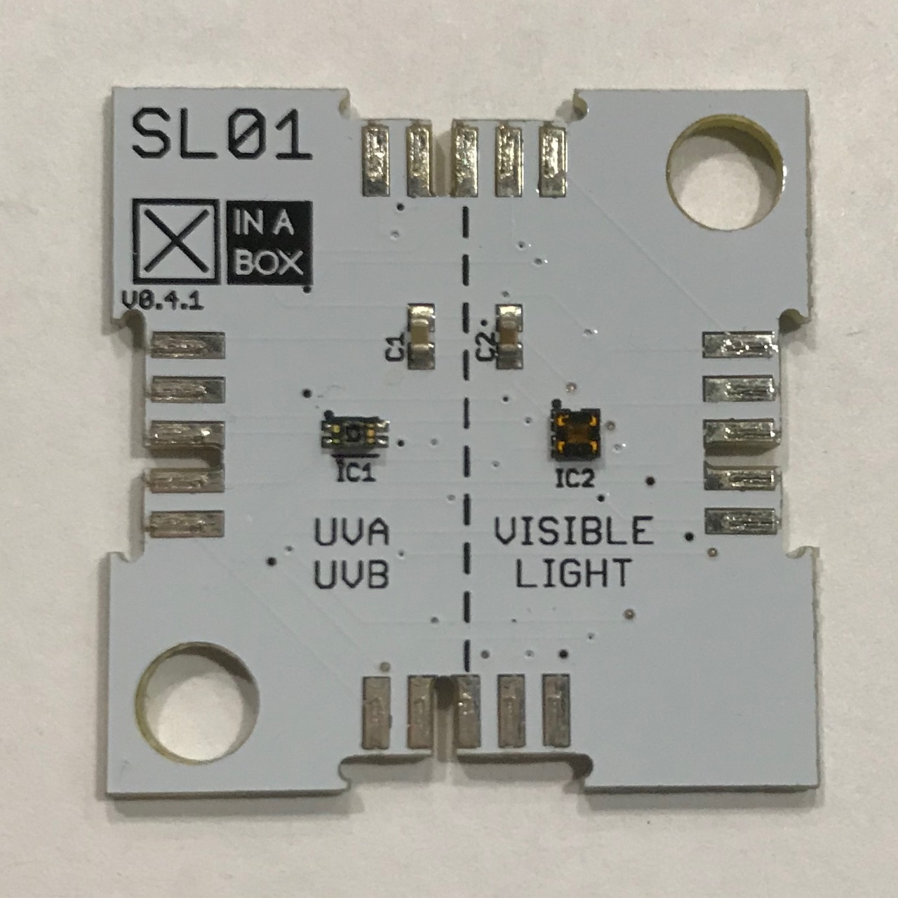
SL01
The Light Chip
This chip collects light intensity (LUX), UVA and UVB data

Slide 5
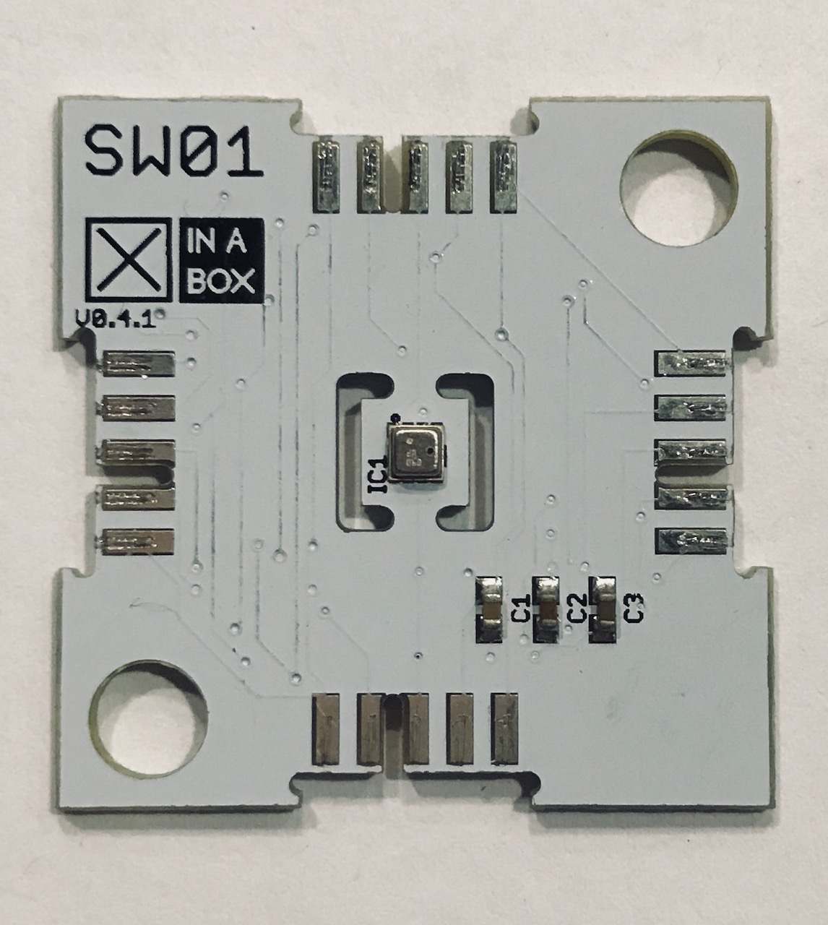
SW01
The Weather Chip
This sensor collects Temperature, Humidity, Air Pressure and Altitude datat

Slide 6
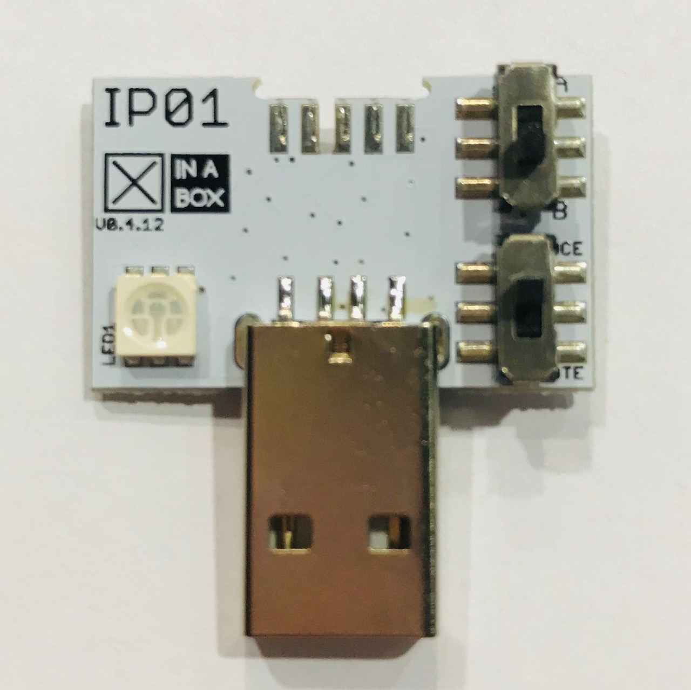
IP01
The USB Chip
This module provides power and data connectivity when plugged into your USB port.

Slide 7
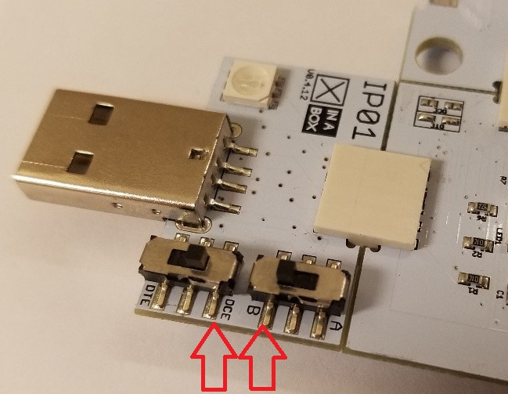
Switches
When you are uploading code to your XinaBox Kit, make sure your switches are in “B” and “DCE”

Slide 8
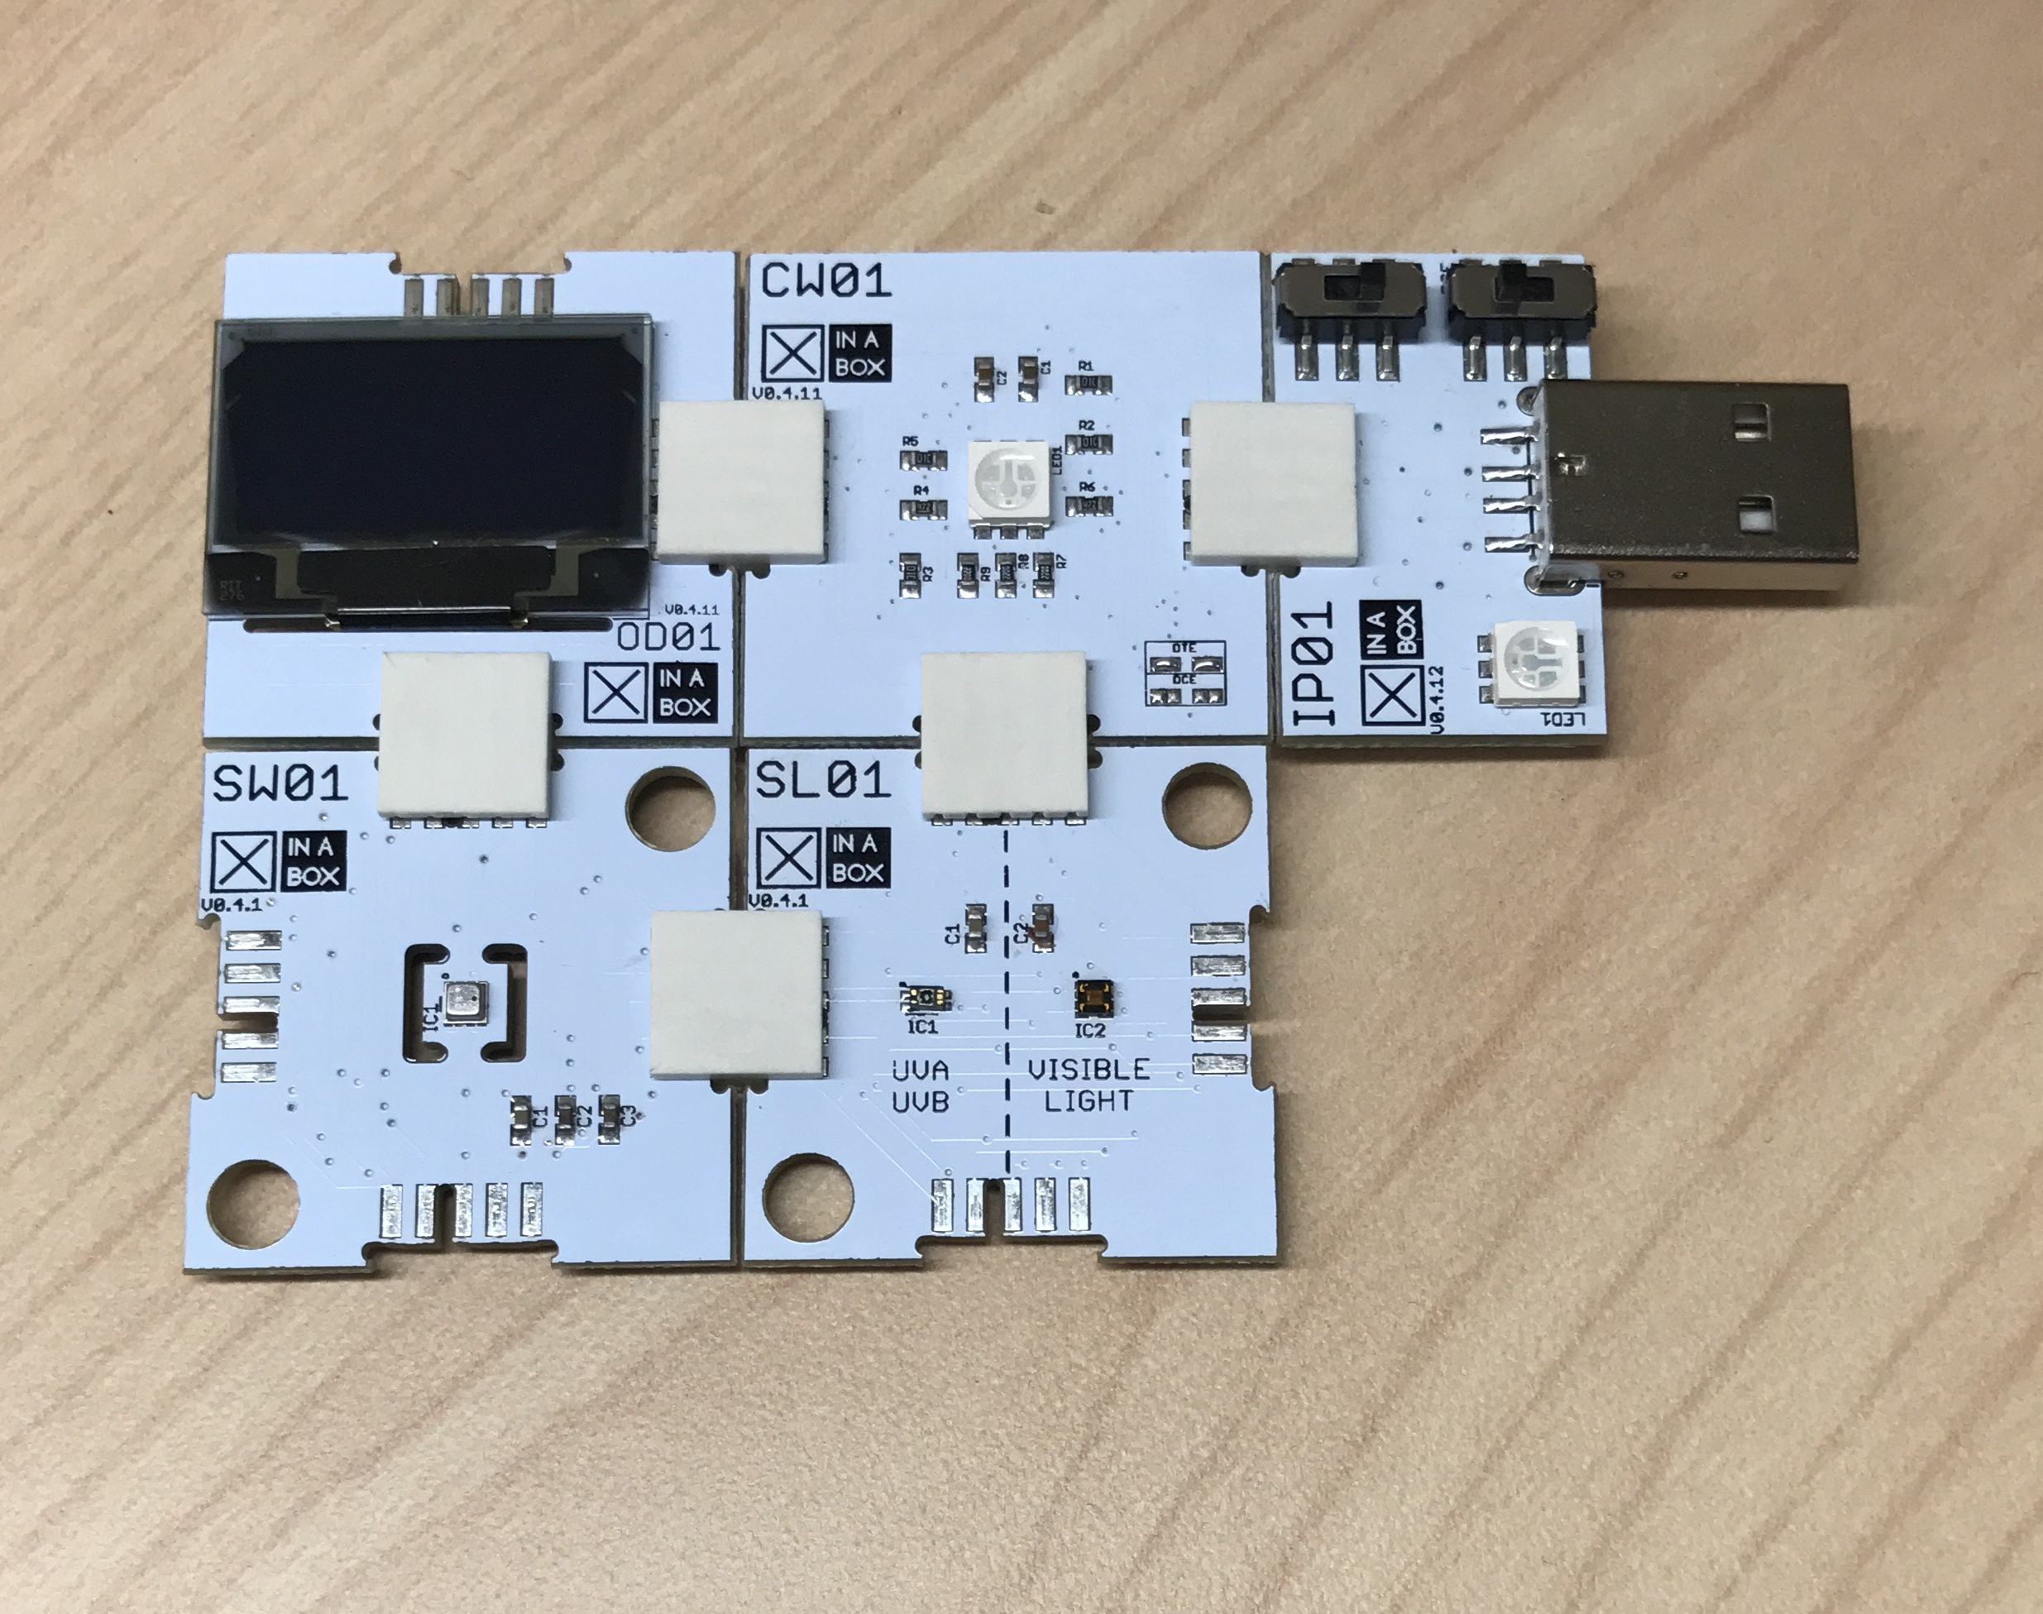
Putting it all together
This is what your engineering model will look like.
This configuration can also be used for all of programming labs.

